Slide 1

Basics of Web Design
Web Development and Operating Systems 1

Slide 2
Learning Outcomes
Describe the evolution of the Internet and the Web
Explain the need for web standards
Describe universal design
Identify benefits of accessible web design
Identify reliable resources of information on the Web
Identify ethical use of the Web
Describe the purpose of web browsers and web servers
Identify Internet protocols
Define URIs and domain names

Slide 3
INTRODUCTION

Slide 4
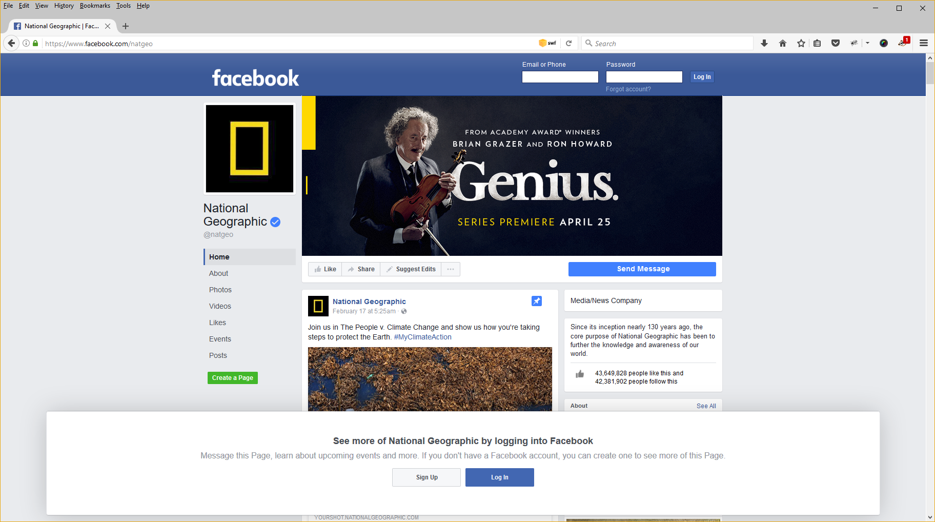
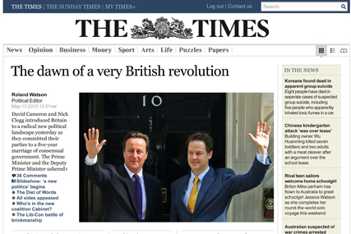
Web Page vs Web site
Webpage: is a document stored on a web server which can be accessed and viewed using a web browser on a computer or mobile device
It can contain : Graphics, audio and video. Hyperlinks to other documents on the World Wide Web
Website : is a collection of related webpages.

Slide 5
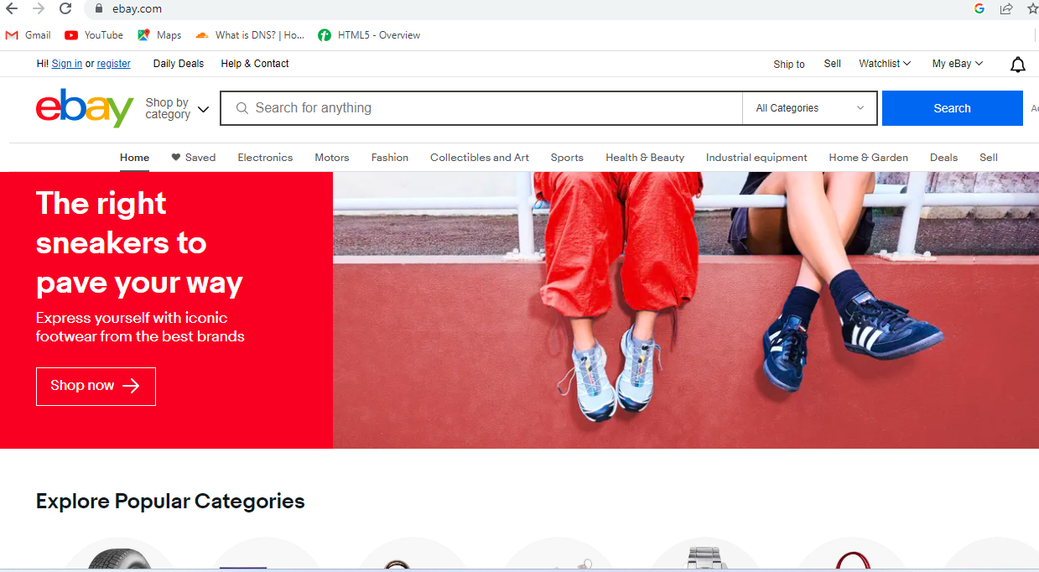
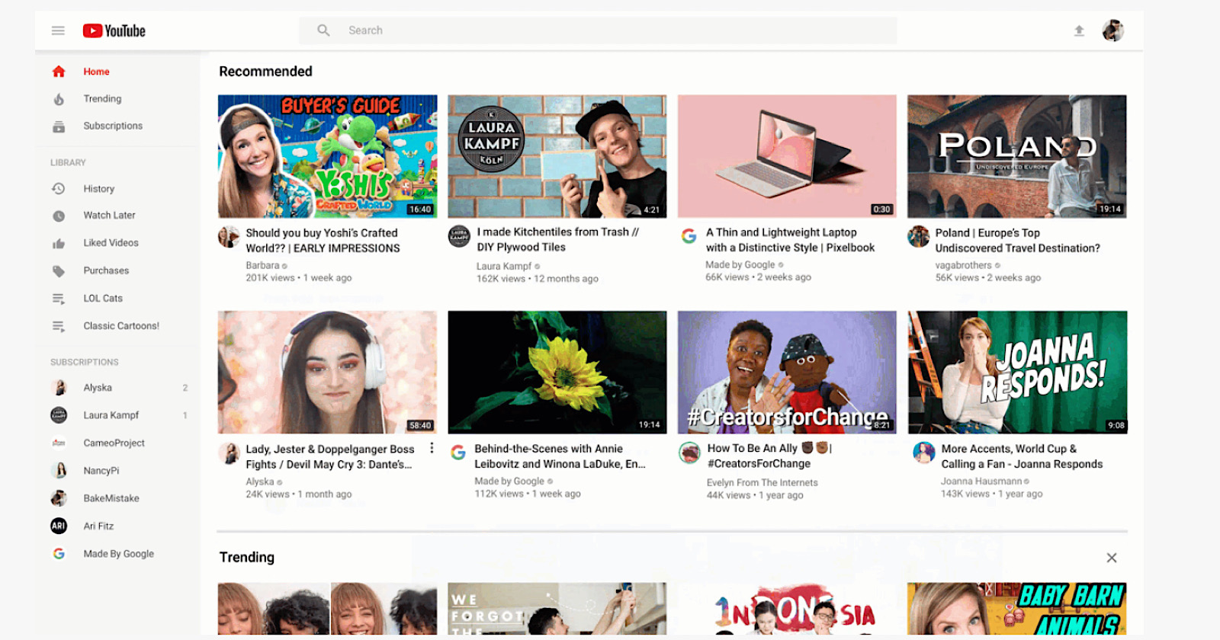
Why web sites??
A website is developed to build a relationship with a target audience and are created for the following reasons:
Sell – to sell products or services.
Advertises and/or demonstrates a product or service.
Provides customer support.
Often includes a database (or catalog) of products and services.
Examples: Microsoft.com, ebay, youtube, gmails etc..

Slide 6
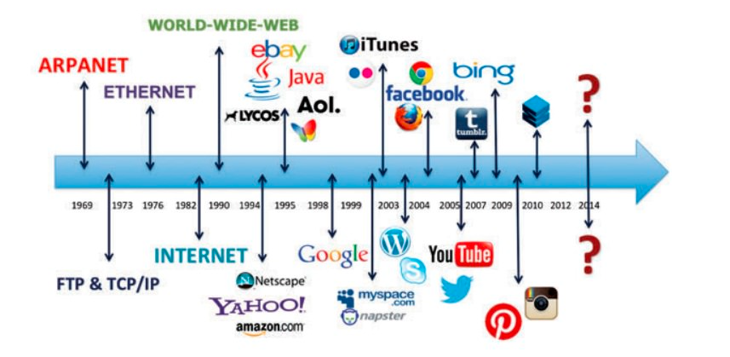
The Evolution of the Internet

Slide 7
The Evolution of the Internet
Internet
ARPANET, which stands for the Advanced Research Project Agency Network, was developed in 1969. It initially connected four computers, marking the birth of the interconnected network of computer networks.
NSFnet was established to expand the network's reach beyond government and academic use.
Use of the Internet was originally limited to government, research and academic use.
In 1991, a significant milestone was reached when the commercial ban on the internet was lifted. leading to the vibrant digital landscape we have today.

Slide 8
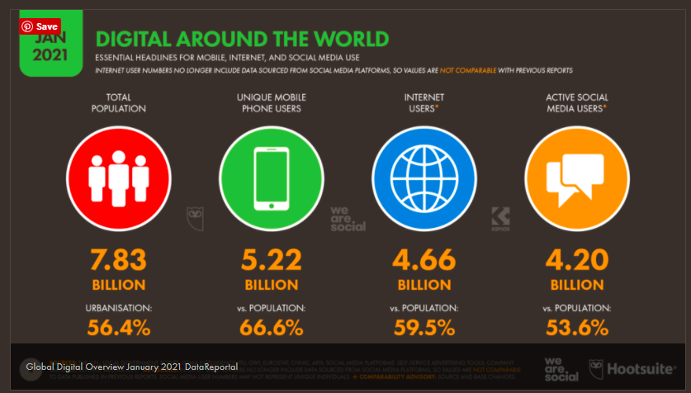
Growth of the Internet
Figure taken from: https://datareportal.com/reports/digital-2021-global-overview-report

Slide 9
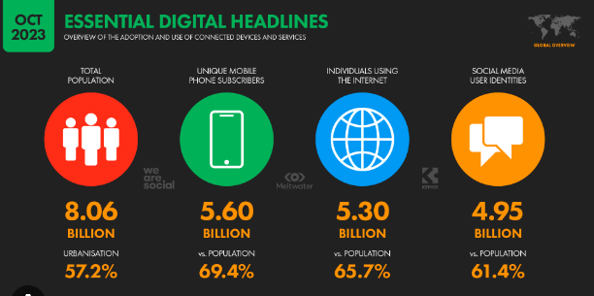

Slide 10
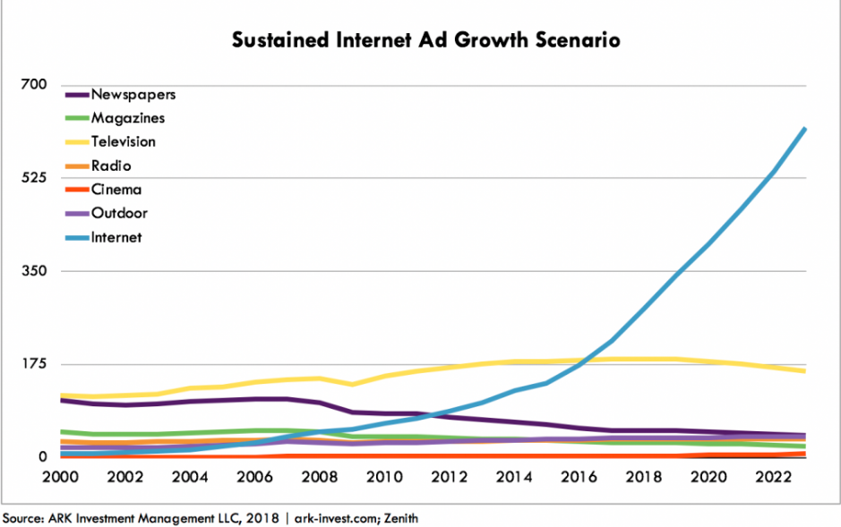
Advertisement growth

Slide 11
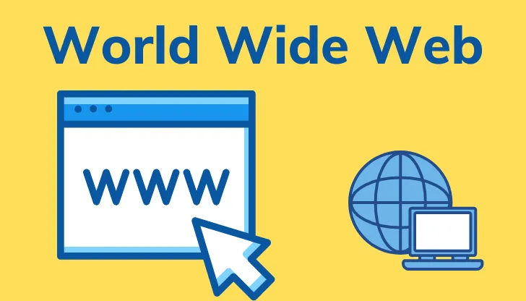

The World Wide Web
The graphical user interface provides access to information stored on some of the computers connected to the internet.
Notes:
The World Wide Web (WWW), often referred to as the "web," is a system of interconnected documents and resources linked through hyperlinks. It is a part of the broader Internet and allows users to access and share information, multimedia content, and services.

Slide 12
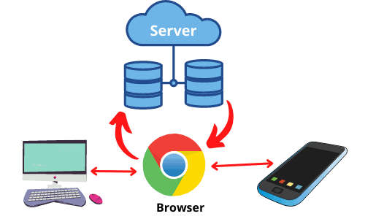
How The World Wide Web Works?

Slide 13
Web Standards and the W3C Consortium
W3C – World Wide Web Consortium
(W3C) is an international community that develops and maintains web standards and guidelines.
W3C's primary mission is to create and promote web standards and recommendations that enhance the functionality, accessibility, and interoperability of the web.
These standards are essential for ensuring that websites and web applications work consistently across different browsers and devices.

Slide 14
Web Accessibility
“The power of the Web is in its universality. Access by everyone regardless of disability is an essential aspect.” – Tim Berners-Lee
Accessible Websites provide accommodations that help individuals to individuals with visual, auditory, physical, and neurological disabilities overcome barriers
WAI – Web Accessibility Initiative
Develops accessibility recommendations
WCAG 2.0
Web Content Accessibility Guidelines http://www.w3.org/WAI/WCAG20/quickref/

Slide 15
Web Accessibility
Section 508 of the Rehabilitation Act
Requires that government agencies must give individuals with disabilities access to information technology that is comparable to the access available to others

Slide 16
Universal Design
“The design of products and environments to be usable by all people, to the greatest extent possible, without the need for adaptation or specialized design.”

Slide 17
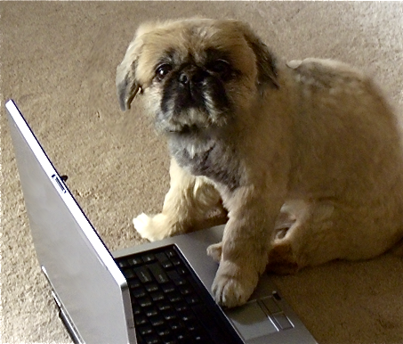
Information on the Web
Reliability and information
Evaluate the credibility of the site
Ethical use of information
Copyright and the Web

Slide 18
Advantages of having Web Standards
Helps ensure webpages display consistently in all browsers.
Faster website development.
Faster downloading of websites.
Equal access to information.
Differences in browser and/or operating system versions do not limit the user’s access to the site.
Differences in hardware do not limit the user’s access to the site

Slide 19
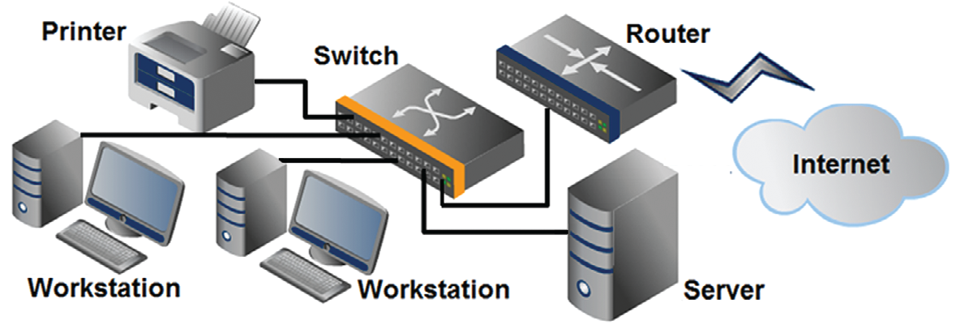
Network Overview
Network two or more computers connected together for the purpose of communicating and sharing resources

Slide 20
The Client/Server Model
Client/Server can describe a relationship between two computer programs – the "client" and the "server".
Client
requests some type of service (such as a file or database access) from the server.
Server
fulfills the request and transmits the results to the client over a network

Slide 21
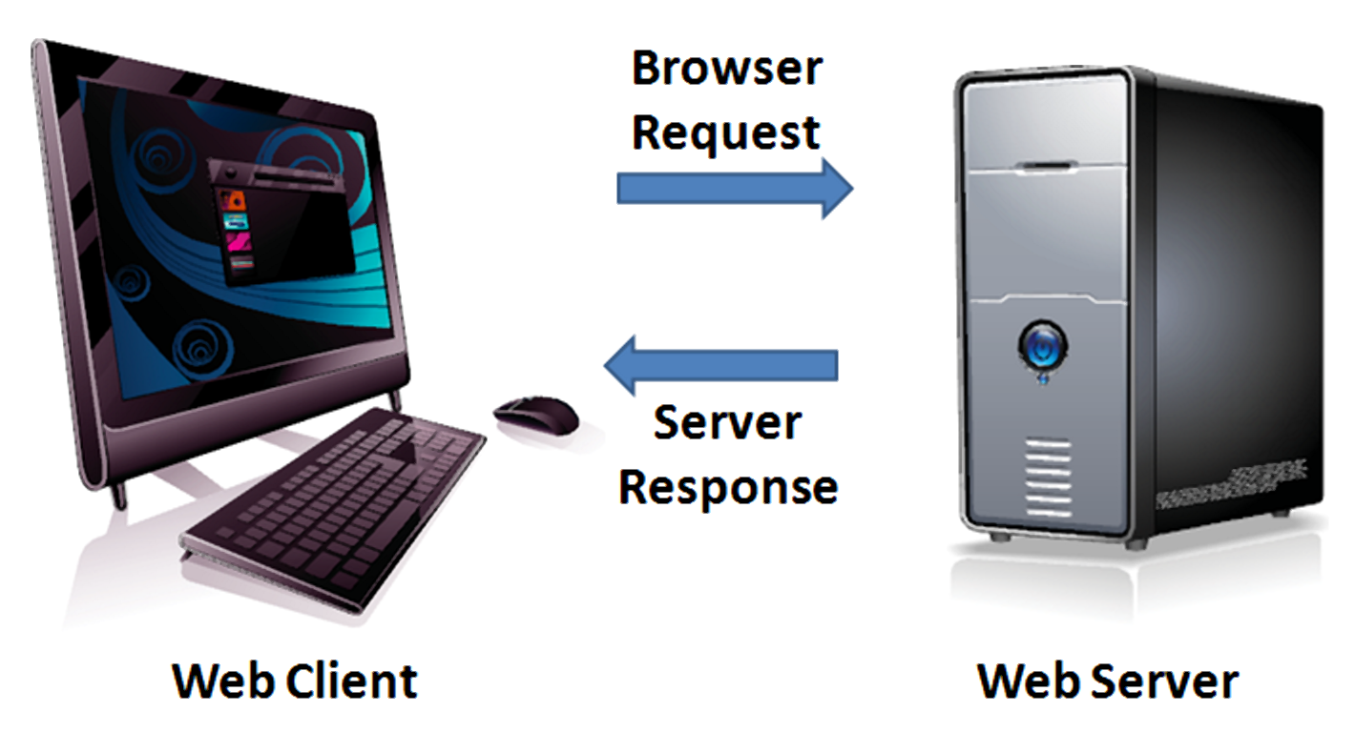
The Client/Server Model
The Internet Client/Server Model
Client: Web Browser
Server: Web Server

Slide 22
Internet Protocols
Protocols
Rules that describe the methods used for clients and servers to communicate with each other over a network.
There is no single protocol that makes the Internet and Web work.
A number of protocols with specific functions are needed.

Slide 23
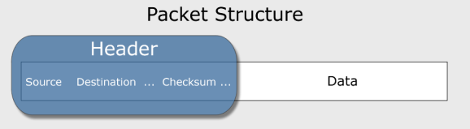
Common Internet Protocols
Official Communication Protocol: TCP/IP
Specialized Protocols:
File Transfer: FTP
E-mail: SMTP, POP3, IMAP
Websites: HTTP

Slide 24
HTTP Hypertext Transfer Protocol
A set of rules for exchanging files such as text, graphic images, sound, video, and other multimedia files on the Web.
Web browsers send HTTP requests for web pages and their associated files.
Web servers send HTTP responses back to the web browsers.
HTTP Request
HTTP Response

Slide 25
IP Address
Each device connected to the Internet has a unique numeric IP address.
These addresses consist of a set of four groups of numbers, called octets. 172.217.19.36 will get you Google!
An IP address may correspond to a domain name.

Slide 26
Domain Name
Locates an organization or other entity on the Internet
Domain Name System
Divides the Internet into logical groups and understandable names
Associates unique computer IP Addresses with the text-based domain names you type into a web browser
Browser: http://google.com
IP Address: 172.217.19.36

Slide 27
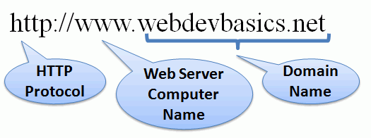
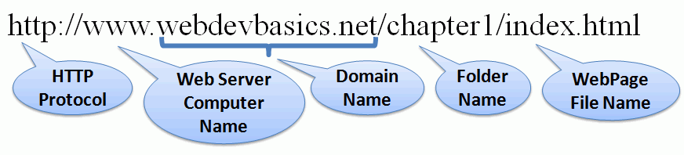
URI Uniform Resource Indicator
Represents the address of a resource on the Internet.

Slide 28
TLD Top-Level Domain Name
A top-level domain (TLD) identifies the right-most part of the domain name.
Some generic TLDs: .com, .org, .net, .mil, .gov, .edu, .int, .aero, .asia, .cat, .jobs, .name, .biz, .museum, .info, .coop, .pro, .travel

Slide 29
Country Code TLDs
Two character codes originally intended to indicate the geographical location (country) of the web site.
In practice, it is fairly easy to obtain a domain name with a country code TLD that is not local to the registrant.
Examples:
.lk, .au, .jp, .uk
See http://www.iana.org/cctld/cctld-whois.htm

Slide 30


Domain Name System
The Domain Name System (DNS) associates Domain Names with IP addresses.
Domain Name
DNS
IP Address
Web Browser requests web page
Web Server
Use TPC/IP to send HTTP Request
Use TCP/IP to send HTTP Responses with web page files & images
Web Browser displays web page
30

Slide 31
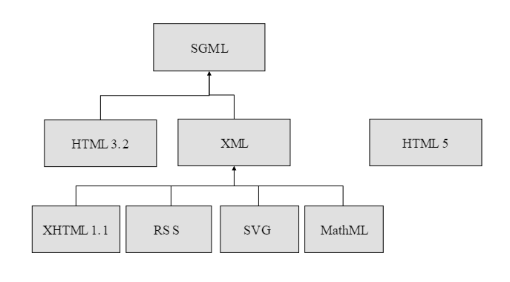
Markup Languages
SGML – Standard Generalized Markup Language
A standard for specifying a markup language or tag set
HTML – Hypertext Markup Language
The set of markup symbols or codes placed in a file intended for display on a web browser.
Element or tag – individual markup code
Attribute – modifies the purpose of a tag

Slide 32

Markup Languages (cont.)
HTML 5
The next version of HTML 4 and XHTML 1
Currently in draft status
Incorporates features of both HTML and XHTML
Adds new elements
Eliminates some elements
Cross platform compatibility

Slide 33
What We do ?
Markup Languages
HTML
Cascading Style Sheets (CSS)
Scripting languages
Javascript
Web creation and editing software
Visual studio code

Slide 34

Summary
This chapter provided a brief overview of Internet, Web, and introductory networking concepts along with what you are going to implement.
Questions?

